Slide 1
Agent Based Model for Simulating Herd Dynamics
Beth Johnson
johnsel@math.umd.edu
Advisor:
Dr. Bill Fagan
Department of Biology
bfagan@umd.edu

Slide 2
Background
There are many different mechanisms that animals may use to direct movement
Non-oriented – random movement
Oriented – movement directed by a stimulus (visual observation of food)
Spatial memory – uses previous information, passed through individuals or generations
Animals may use more than one or all three movement mechanisms
No current movement theory to unify all three mechanisms

Slide 3
Background
There are three different population level distributions that animals exhibit
Sedentary ranges – individual occupies relatively small area compared to population range
Migration – regular movement to and from spatially disjoint ranges
Nomadism – does not follow regular temporal and spatial patterns
Need a way to evaluate and qualify dispersion patterns at the population level that does not rely on an assumption of one of these three types of distributions

Slide 4
Approach – ‘Evolve’ an Agent Based Model with ANN
Fix landscape variability
Evolve agents for landscape (stage 1)
Create herd from best agent
(stage 2)
Determine spatial statistics
Realized Movement Index
Population Dispersion Index
Movement Correlation Index
Gazelle Relocation Data

Slide 5
Landscape
resource patches
allowed movements for next time step
+
agent

Slide 6
Landscape Variability
Patch size
1
75%
Predictability
generations
50%

Slide 7
Landscape Validation
Expect that there is uniform placement of patches everywhere that is not a constant patch
Expect that total number of resources consumed by individual + number of resources remaining is constant

Slide 8
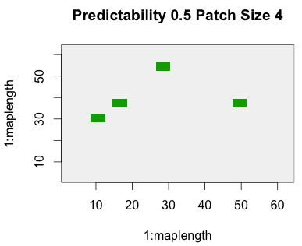
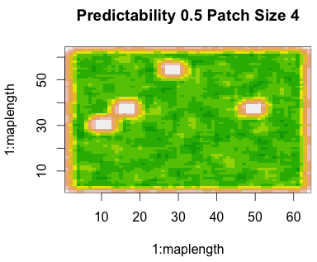
Landscape Validation
Without constant patches removed
With constant patches removed
The following plots show number of resources per cell over 5000 generations, with constant patches removed (as constant patches all have 5000 resources)

Slide 9
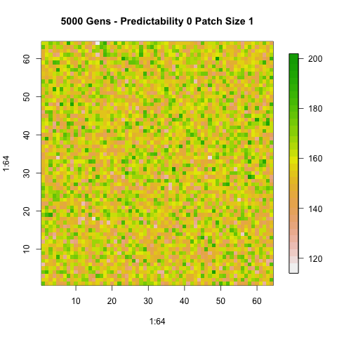
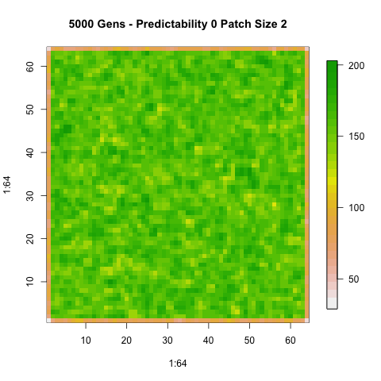
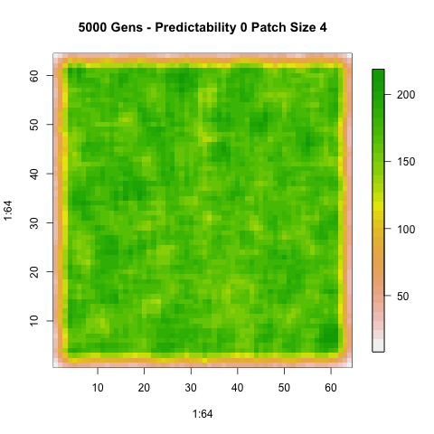
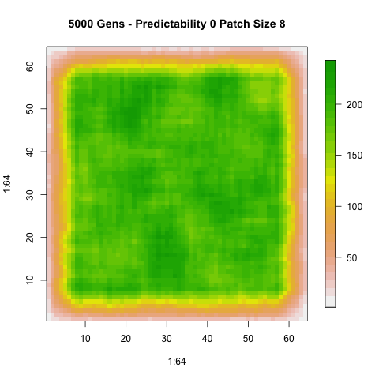
Landscape Validation – 0%

Slide 10
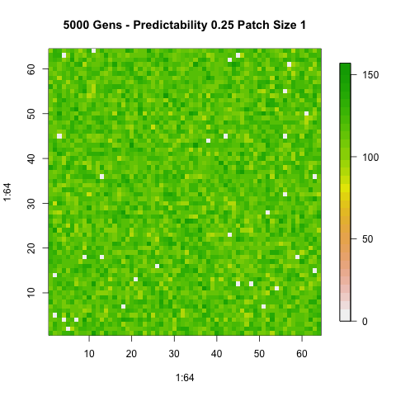
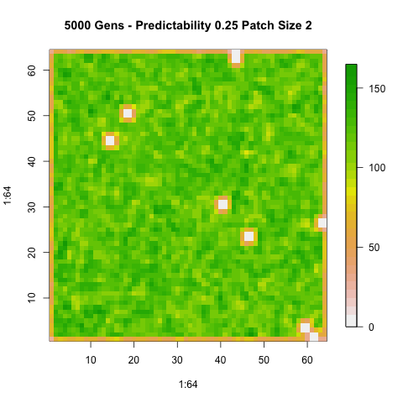
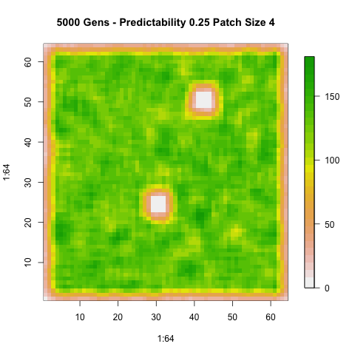
Landscape Validation - 25%

Slide 11
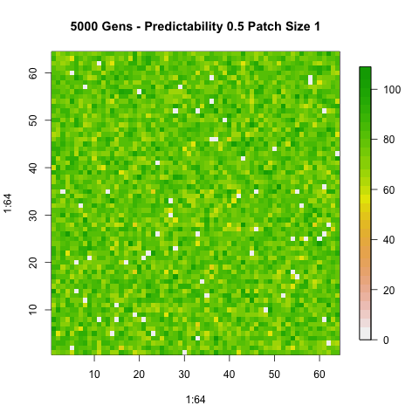
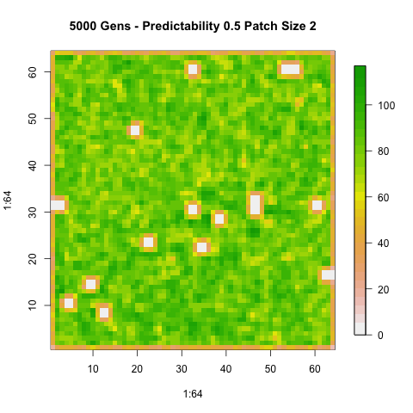
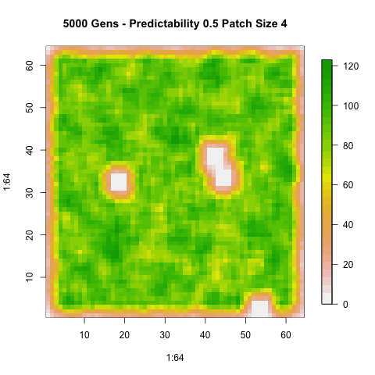
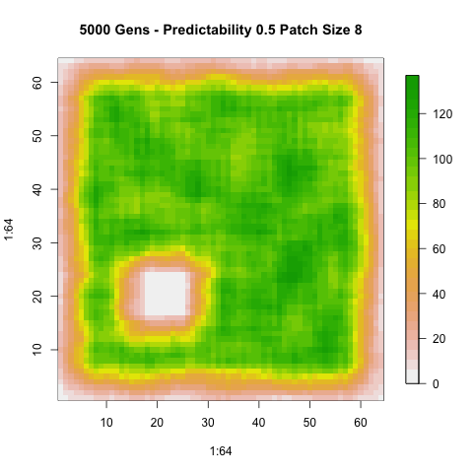
Landscape Validation – 50%

Slide 12
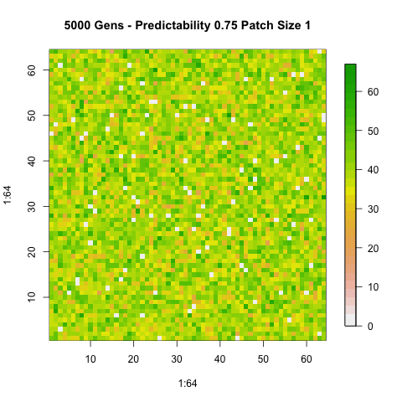
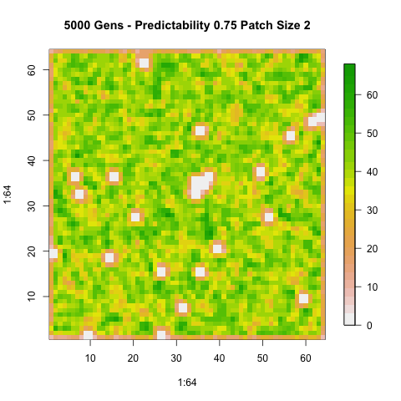
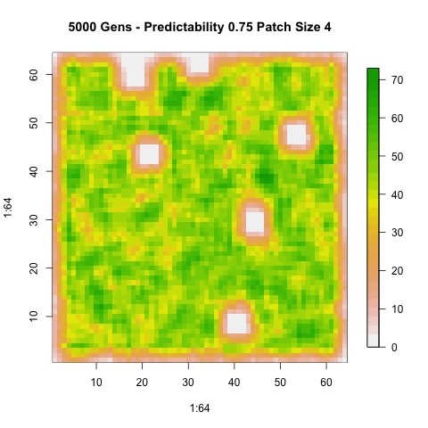
Landscape Validation – 75%

Slide 13
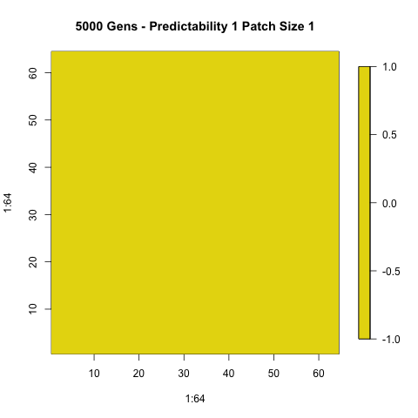
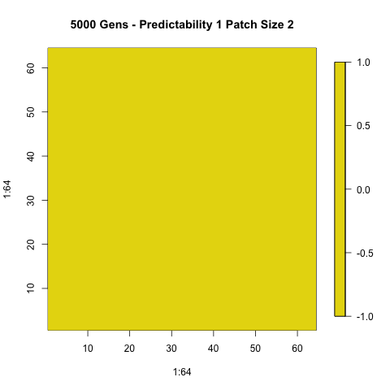
Landscape Validation – 100%

Slide 14
Agent Movement
Mechanism
Input Layer
Hidden Layer
Output Layer
Bias
non-oriented
Resource Uptake (total)
1
5
Resource Uptake (last 8 steps)
Search Effort
2
4
oriented
Resources in 8-cell neighborhood
spatial memory
Current x location
Current y location
3
6
Step counter
Inputs are scaled to be [-1,1], values at hidden and output nodes determined by the following, where weights are integers [-5,5]
Mueller, Thomas, William F. Fagan, and Volker Grimm. "Integrating individual search and navigation behaviors in mechanistic movement models.” Theoretical Ecology 4.3 (2011): 341-355.

Slide 15
Agent Movement
[0, ¹/₃)
[¹/₃,²/₃)
If Output Node 4 is __
Non-oriented: If Output Node 5 is __
Oriented: If __ resources are visible
[²/₃,1]
Move same direction as previous time step
Go to resource
Memory:
If Output Node 6 is __
[0, ¹/₃)
1
Move 45 degrees from direction in previous time
Go to randomly selected resource
[¹/₃,²/₃)
>1
Move in random direction
[²/₃,1]
0

Slide 16
Agent Movement Validation
Used test cases in corners of maps to confirm appropriate choice of direction
For each test case, the following were set:
Weights
Input variables
Visible resources
Previous direction

Slide 17
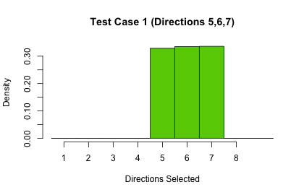
Test Case 1
Node | Value
Output Node 4 | 0.810
Output Node 5 | 0.906
Output Node 6 | 0.004
Memory:
If Output Node 6 is __

Slide 18
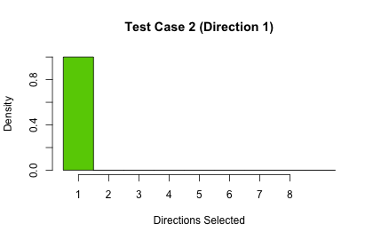
Test Case 2
Node | Value
Output Node 4 | 0.981
Output Node 5 | 0.003
Output Node 6 | 0.052
Memory:
If Output Node 6 is __

Slide 19
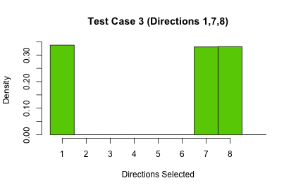
Test Case 3
Node | Value
Output Node 4 | 0.501
Output Node 5 | 0.501
Output Node 6 | 0.490
Go to resource
1
Go to randomly selected resource
>1
Oriented: If __ resources are visible
Move in random direction
0

Slide 20
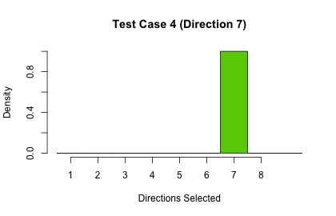
Test Case 4
Node | Value
Output Node 4 | 0.501
Output Node 5 | 0.501
Output Node 6 | 0.490
Go to resource
1
Go to randomly selected resource
>1
Oriented: If __ resources are visible
Move in random direction
0

Slide 21
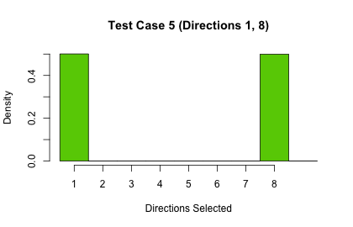
Test Case 5
Node | Value
Output Node 4 | 0.267
Output Node 5 | 0.504
Output Node 6 | 0.048
Move same direction as previous time step
[0, ¹/₃)
Move 45 degrees from direction in previous time
[¹/₃,²/₃)
Non-oriented: If Output Node 5 is __
Move in random direction
[²/₃,1]

Slide 22
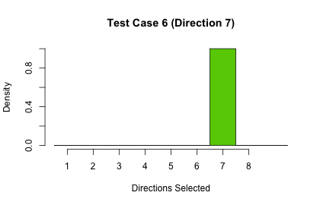
Test Case 6
Node | Value
Output Node 4 | 0.269
Output Node 5 | 0.501
Output Node 6 | 0.047
Move same direction as previous time step
[0, ¹/₃)
Move 45 degrees from direction in previous time
[¹/₃,²/₃)
Non-oriented: If Output Node 5 is __
Move in random direction
[²/₃,1]

Slide 23
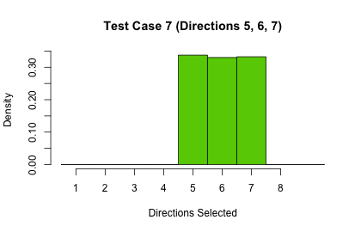
Test Case 7
Node | Value
Output Node 4 | 0.267
Output Node 5 | 0.504
Output Node 6 | 0.048
Move same direction as previous time step
[0, ¹/₃)
Move 45 degrees from direction in previous time
[¹/₃,²/₃)
Non-oriented: If Output Node 5 is __
Move in random direction
[²/₃,1]

Slide 24
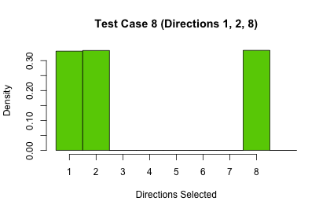
Test Case 8
Node | Value
Output Node 4 | 0.267
Output Node 5 | 0.484
Output Node 6 | 0.055
Move same direction as previous time step
[0, ¹/₃)
Move 45 degrees from direction in previous time
[¹/₃,²/₃)
Non-oriented: If Output Node 5 is __
Move in random direction
[²/₃,1]

Slide 25
Test Case 9
Node | Value
Output Node 4 | 0.500
Output Node 5 | 0.952
Output Node 6 | 0.050
Go to resource
1
Go to randomly selected resource
>1
Oriented: If __ resources are visible
Move in random direction
0

Slide 26
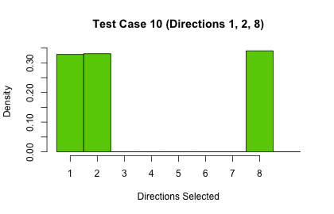
Test Case 10
Node | Value
Output Node 4 | 0.500
Output Node 5 | 0.952
Output Node 6 | 0.050
Go to resource
1
Go to randomly selected resource
>1
Oriented: If __ resources are visible
Move in random direction
0

Slide 27
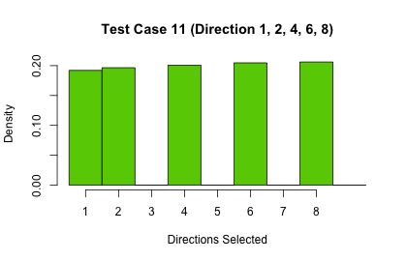
Test Case 11
Node | Value
Output Node 4 | 0.500
Output Node 5 | 0.952
Output Node 6 | 0.050
Go to resource
1
Go to randomly selected resource
>1
Oriented: If __ resources are visible
Move in random direction
0

Slide 28
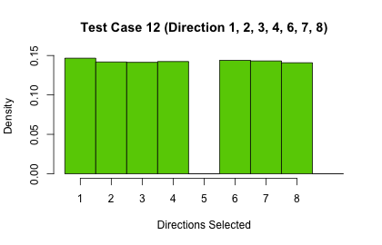
Test Case 12
Node | Value
Output Node 4 | 0.500
Output Node 5 | 0.952
Output Node 6 | 0.050
Go to resource
1
Go to randomly selected resource
>1
Oriented: If __ resources are visible
Move in random direction
0

Slide 29
Evolve agents for landscape
Set landscape
Select random starting location
Allow agent i to move 1 step across landscape
for 1:time steps
Randomly initialize weights of agents
Record resources, update landscape
for agents i < N
Create 6 copies of that agent
(with mutation + crossover)
Find agent with most resources
Randomly select 6 agents
Until all agents selected

Slide 30
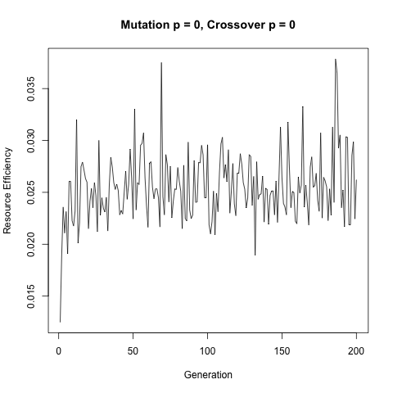
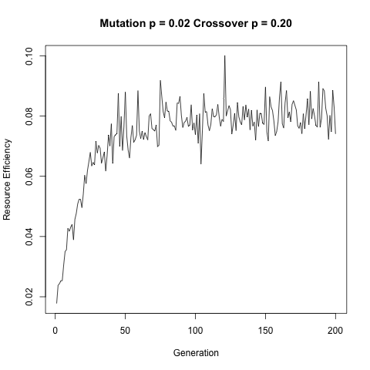
Evolution Validation
Edge cases: if crossover rate, mutation rate = 0, efficiency should be constant after a few generations (pred = 0.5, patch size = 4)

Slide 31
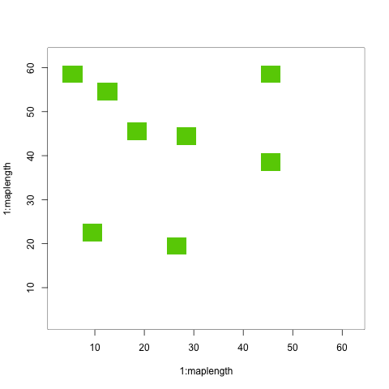
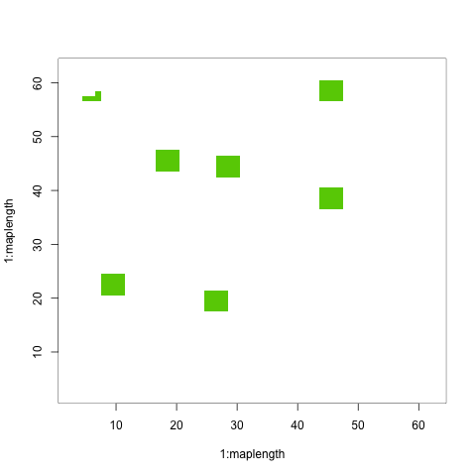
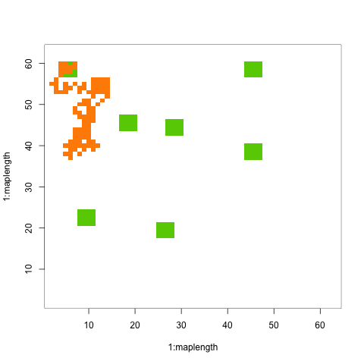
Overall Stage 1 Implementation
Agent with most resources in generation 1
(pred = 0.5, patch size = 4)

Slide 32
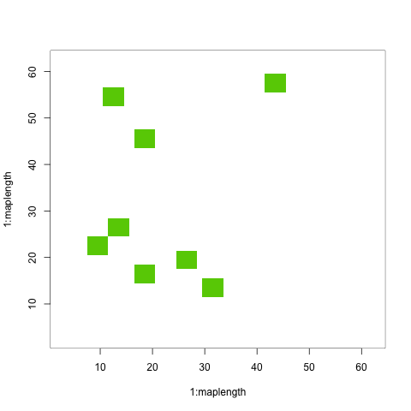
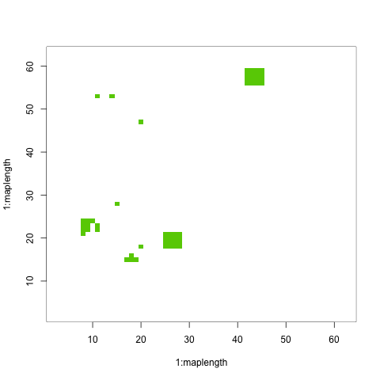
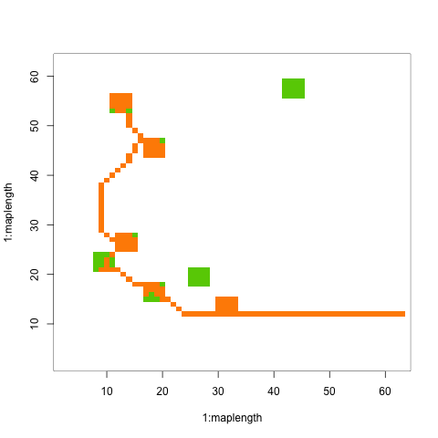
Overall Stage 1 Implementation
Agent with most resources in generation 100
(pred = 0.5, patch size = 4)

Slide 33
Overall Stage 1 Implementation
Max resource (generation 1): 28
Max resource (generation 100): 77

Slide 34
Speed + Memory Use – 100 gen
self.time(s) self% total.time total% mem.total(Mb)
"determineDirection" 531.16 32.97 859.34 53.35 229239.0
"gen" 298.62 18.54 1610.88 100.00 431330.0
"@<-" 115.36 7.16 115.36 7.16 30779.1
"seeMap" 89.04 5.53 103.92 6.45 28327.3
"match" 85.80 5.33 90.50 5.62 24135.2
"el" 76.84 4.77 76.84 4.77 20226.1
"checkAtAssignment" 68.24 4.24 466.34 28.95 123165.7
"elNamed" 51.88 3.22 225.20 13.98 59654.8
".getClassFromCache" 49.40 3.07 85.04 5.28 22152.6
".Call" 47.96 2.98 47.96 2.98 12471.3
"getClass" 35.52 2.21 120.46 7.48 31451.1
".identC" 33.74 2.09 51.90 3.22 13863.8
"+" 23.06 1.43 23.06 1.43 5988.5
"*" 10.90 0.68 10.90 0.68 3133.6
"-" 10.18 0.63 10.18 0.63 2555.4
"sample.int" 8.20 0.51 8.30 0.52 2346.2
"c" 8.06 0.50 8.06 0.50 2191.3
"/" 7.02 0.44 7.02 0.44 2149.9
"is.na" 6.24 0.39 6.24 0.39 1572.8
"sum" 6.00 0.37 6.00 0.37 1732.5
"is.list" 5.86 0.36 5.86 0.36 1530.3
"which" 5.60 0.35 6.54 0.41 1621.1
"==" 5.14 0.32 5.14 0.32 1310.2
"names" 4.70 0.29 4.70 0.29 1281.5
"exp" 4.28 0.27 4.28 0.27 905.8
"sample" 4.00 0.25 15.44 0.96 4335.7
"!=" 3.48 0.22 3.48 0.22 1064.0
"numeric" 2.96 0.18 2.96 0.18 922.7
":" 2.82 0.18 2.82 0.18 580.8

Slide 35
Speed + Memory Use – 100 gen
self.time(s) self% total.time total% mem.total(Mb)
">" 2.40 0.15 2.40 0.15 666.9
"min" 1.52 0.09 1.52 0.09 354.6
"<" 1.46 0.09 1.46 0.09 409.2
"(" 1.36 0.08 1.36 0.08 380.2
"matrix" 0.86 0.05 0.86 0.05 172.2
"length" 0.28 0.02 0.28 0.02 130.3
"standardGeneric" 0.28 0.02 0.28 0.02 99.8
"vectorToMap" 0.24 0.01 1.14 0.07 205.6
".External" 0.18 0.01 0.18 0.01 41.0
"possibleExtends" 0.16 0.01 0.62 0.04 102.3
"getClassDef" 0.04 0.00 0.14 0.01 22.8
"initFirstAgents" 0.02 0.00 0.08 0.00 8.8
"as.list" 0.02 0.00 0.02 0.00 0.0

Slide 36
Time Percentages per function

Slide 37
Project Schedule/Milestones
October – Set up data structures for agents, code to initialize landscape and agents
November – Implement and validate genetic algorithm + neural networks
December - Implement stage 1 (evolving agents) create mid year report and presentation
Late January - Implement stage 2 (herd of agents)
Feb – Implement RMI, PDI, and MCI
March - Validate overall agent model and spatial metrics
April – Test spatial metrics with gazelle data + simulation data
May – Create final report + presentation, documentation + examples for spatial metrics code
Time permitting: parallel versions of spatial metrics(if necessary with large data sets), parallel version of agent based model (stage 1), visualization of simulation

Slide 38
References
Calabrese, Justin, Chris H. Fleming, Bill F. Fagan, Marin Rimmler, Petra Kaczensky, Peter Leimgruber, and Thomas Mueller. From the fish tank to the Gobi desert: A general, scalable approach to quantifying animal movement coordination. (Unpublished, 2013)
Kirkpatrick, David G., and Raimund Seidel. "The ultimate planar convex hull algorithm?." SIAM journal on computing 15.1 (1986): 287-299.
Lotwick, H. W., and B. W. Silverman. "Methods for analysing spatial processes of several types of points." Journal of the Royal Statistical Society. Series B (Methodological) (1982): 406-413.
Mueller, Thomas, William F. Fagan, and Volker Grimm. "Integrating individual search and navigation behaviors in mechanistic movement models."Theoretical Ecology 4.3 (2011): 341-355.
Mueller, Thomas, and William F. Fagan. "Search and navigation in dynamic environments–from individual behaviors to population distributions." Oikos117.5 (2008): 654-664.
Mueller, Thomas, et al. "How landscape dynamics link individual‐to population‐level movement patterns: a multispecies comparison of ungulate relocation data." Global Ecology and Biogeography 20.5 (2011): 683-694.

